Slide 1
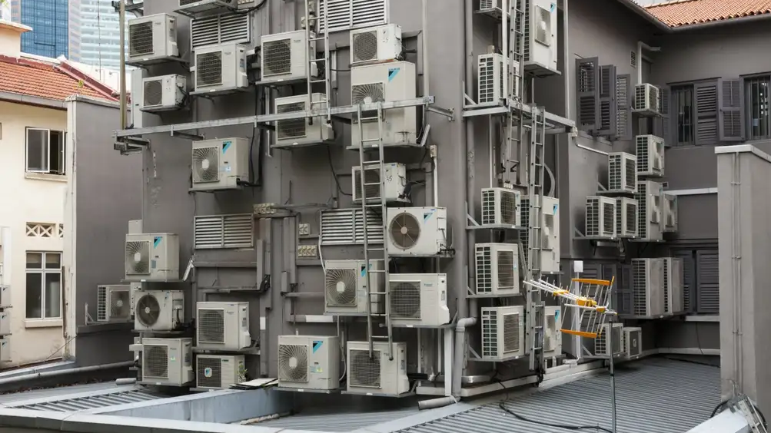

Training on Integrated Progress Report
Energy Efficiency – Annex IV & XVII
Ph.D. Stephane Quefelec European Environment Agency
8 October 2025 Sarajevo
Notes:
I used this image as a provocation, as an incorrect example.

Slide 2
Agenda
What to report on energy efficiency:
Thematic aspects: Annex IV – EEA
Thematic aspects: Annex XVII – EEA
Real life experience: insight from Spain
How to report:
Reportnet 3 – EEA – General intro
Exercise - EEA
Logging in & set-up
Data input – overview
Data input – excel import
Data input – excel export
Quality assurance – validations
Release of data - submission
Notes:
To provide an interactive demo of reporting on Annex IV and XVII through the reporting platform Reportnet 3.0

Slide 3
Objective and expected result
=> At the end of the session, you will know WHAT to report and HOW to use the templates and the Reportnet 3 platform to report the data on Annex IV and XVII.

Slide 4
Welcome
Your speakers for this meeting:
Stéphane QUEFELEC – EEA – Climate Neutrality, Energy and Mobility (EEA/CMT 1)
Sofía Rodríguez Pita – Spain – Lead Reporter – Annex IV and XVII
Notes:
Stéphane QUEFELEC
Ils will present MS expereince in these annexes

Slide 5

National Energy and Climate Progress Reporting
Context

Slide 6



The Adapted Governance Regulation: planning & reporting
National Energy and Climate Plans
(NECP)
2018/9 & 2023/4 (+10yr)
(………….+5 yr)
National Energy and Climate Progress Report
(NECPR)
15 Mar. 2025 (+2yrs)
Adapted Governance Regulation 2018/1999: Article 3, 9, 14, 17

Slide 7
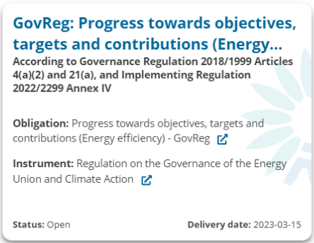
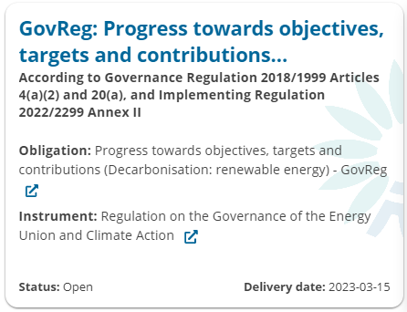
Energy Communities NECPR: EEA dataflow overview
Dataflow = a survey within the reporting platform containing information from particular reporting obligation(s) which can be submitted independently from other obligations.
GHG progress to targets
Annex I
Renewables progress to targets
Annex II
Energy efficiency progress to targets
Annex IV
Renewables additional obligations
Annex XVI
Energy efficiency additional obligations
Annex XVII
Reportnet 3

Slide 8
Dataflows in Reportnet 3: what are we focusing on today?
List of dataflows in Reportnet 3:
NECPR – Progress to targets (GHG)
NECPR – Progress to targets (RES)
NECPR – Progress to targets (EE)
NECPR – Adaptation (Article 17)
NECPR – Additional reporting (RES)
NECPR – Additional reporting (EE)
Integrated National Policies and Measures (PaMs)
National systems for reporting on PaMs and projections
National GHG projections
Adaptation planning and strategies (Article 19)
European Climate Law Recommendations (*)
* This dataflow is aligned with NECPR but is voluntarily provided under the European Climate Law 2021/1119

Slide 9
Overview of prefilled / post-filled data in this dataflow
Annex IV
Table 1
Table 2
Table 3
Reported values
Prefilled
Eurostat Energy balance
Table 4
Table 5
Table 6
Post-filled
Calculated
Annex XVII
Table 1
Table 2
Table 3
Table 4
Table 5
Table 6

Slide 10

Annex IV
Thematic guidance
Notes:
Odysseas PLATSAKIS

Slide 11
PROGRESS TO TARGET - Energy Efficiency
Article 21 (a) – Progress towards objectives, targets, and contributions within energy efficiency
By 15 March 2025 and every second year thereafter, CPs shall report to the Energy Community Secretariat their implementation of the following trajectories and objectives within energy efficiency: National contribution for PEC and FEC; the indicative trajectory PEC and FEC; (3) the indicative milestones and progress indicators of the long-term strategy for the renovation of the national stock of residential and non-residential buildings; (4) where applicable, an update of other national objectives set out in the national plan.
Reports due: | 15 March – Biannually – To start in 2025
Notes:
6 tables
Annex IV, Table 1: National contribution and indicative trajectory for primary and final energy consumption
Annex IV, Table 2_Other: Other milestones and progress indicators of the long-term strategy (LTRS) for the renovation of the national stock of residential and non-residential buildings – building stock
Annex IV, Table 3: Milestones and progress indicators of the long-term strategy for the renovation of the national stock of residential and nonresidential buildings – renovation rates
Annex IV, Table 5: Milestones and progress indicators of the long-term strategy for the renovation of the national stock of residential and nonresidential buildings - the contributions to the CPs energy efficiency targets
Annex IV, Table 4: Milestones and progress indicators of the long-term strategy for the renovation of the national stock of residential and nonresidential buildings – other indicators
Annex IV, Table 6: Update of other national objectives on energy efficiency as reported in the integrated national energy and climate plan

Slide 12
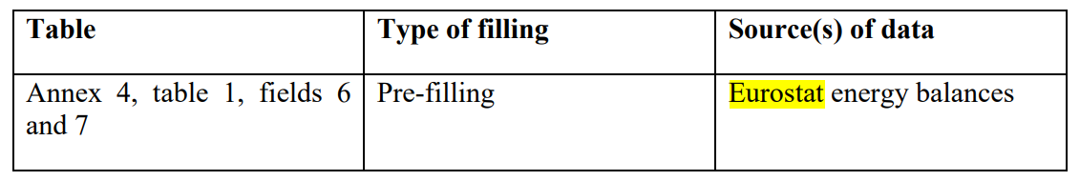
PROGRESS TO TARGET - energy efficiency – Tables
Table 1: National contribution and indicative trajectory for primary and final energy consumption,
Table 2: Milestones and progress indicators of the long-term strategy for the renovation (LTRS) of the national stock of residential and non-residential buildings – building stock ,
Table 2_Other: Other milestones and progress indicators of the long-term strategy for the renovation (LTRS) of the national stock of residential and non-residential buildings – building stock,
Table 3: Milestones and progress indicators of the long-term strategy for the renovation of the national stock of residential and non-residential buildings – renovation rates,
Table 4: Milestones and progress indicators of the long-term strategy for the renovation of the national stock of residential and non-residential buildings – other indicators,
Table 5: Milestones and progress indicators of the long-term strategy for the renovation of the national stock of residential and non-residential buildings - the contributions to the Union's energy efficiency targets,
Table 6: Update of other national objectives on energy efficiency as reported in the integrated national energy and climate plan.
The process for pre-filling:
Progress towards indicative
trajectory 2021-2030 in PEC and FEC.

Slide 13
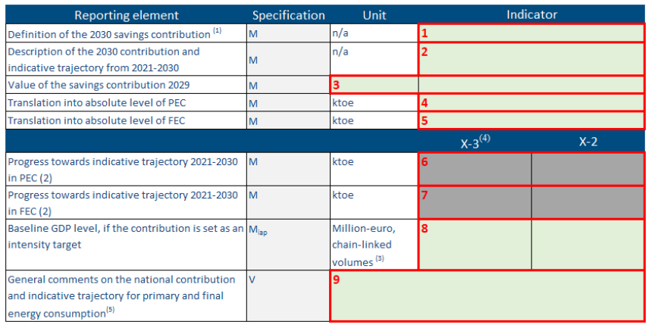
Annex 4 – Table 1
National contribution and indicative trajectory for primary and final energy consumption
Data format: drop-down menu
(2025)
Data format: text
(2030)
Data format: text for unit, number (decimal) for indicator
Data format: number (decimal)
These fields will be pre-filled based on Eurostat energy balance data when available.
(2016)
Mandatory if applicable
Data format: number (decimal)
Voluntary
Data format: number (decimal)
FIELD 1:The purpose of this field is to report their definition of the 2030 savings contribution in accordance with their NECP through the selection of a specific option (i.e., primary energy consumption; final energy consumption; primary energy savings; final energy savings; energy intensity.)
FIELD 2: The purpose of this field is to describe the 2030 contribution and indicative trajectory from 2025-2030;
FIELD 3: The purpose of this field is to document the value of the savings contribution in 2030 in accordance with their NECP.
Notes:
Note: X is the reporting year
, Good examples FIELD 3 later

Slide 14
Annex 4 – Table 1
National contribution and indicative trajectory for primary and final energy consumption
Data format: drop-down menu
(2025)
Data format: text
Data format: text for unit, number (decimal) for indicator
Data format: number (decimal)
These fields will be pre-filled based on Eurostat energy balance data when available.
Mandatory if applicable
Data format: number (decimal)
Voluntary
Data format: number (decimal)
FIELD 4-5: The purpose of this field is to translate the value of the savings contribution 2030 (field 3) into absolute level of PEC (Primary Energy Consumption) or FEC (Final Energy Consumption).
FIELD 8: The purpose of this field is to report the Baseline GDP level, if the contribution is set as an intensity target.
FIELD 9: The purpose of this field is to provide additional explanation on the national contribution and indicative trajectory for primary and final energy consumption, including their underlying methodology.

Slide 15
Annex 4 – Table 1 – Field 3 good examples
National contribution and indicative trajectory for primary and final energy consumption
The savings contribution in 2030 can for example be calculated as follows:
In case it is first defined in terms of maximum level of primary energy consumption, then the value of the savings contribution corresponds to primary energy savings and can be calculated as the difference in the primary annual energy consumption in 2030 between a reference scenario and the target scenario (i.e. the absolute level of primary energy consumption indicated in field 4)
In case it is first defined in terms of maximum level of final energy consumption, then the value of the savings contribution corresponds to final energy savings and can be calculated as the difference in the final annual energy consumption in 2030 between a reference scenario and the target scenario (i.e. the absolute level of final energy consumption indicated in field 5)
In case it is first defined in terms of primary energy savings, then the value of the savings contribution corresponds to primary energy savings and is directly the target adopted by the CPs;
In case it is first defined in terms of final energy savings, then the value of the savings contribution corresponds to final energy savings and is directly the target adopted by the CPs;
In case it is first defined in terms of primary or final energy intensity, then the value of the savings contribution corresponds to either primary or final energy savings. The target in energy intensity needs to be translated in absolute level of energy consumption (as indicated in field 4 for primary energy consumption, or field 5 for final energy consumption). Then the savings contribution can be calculated as the difference in annual energy consumption in 2030 between a reference scenario and the target scenario (i.e. the absolute level of primary or final energy consumption indicated in field 4 or field 5.
Notes:
e.g. PRIMES2020 what is it?

Slide 16
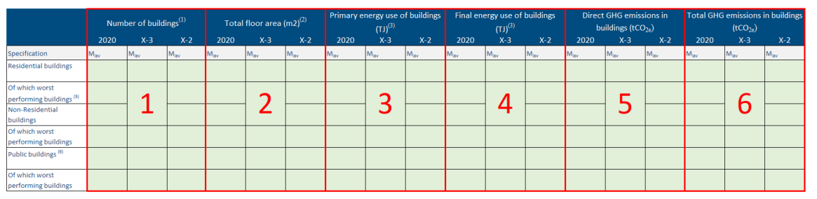
Annex 4 – Table 2
Milestones and progress indicators of the long-term strategy (LTRS) for the renovation of the national stock of residential and non-residential buildings – building stock
Data format: number (integer and decimall)
Mandatory if available, 3 historical years. The years are identified as 2020, X-3 and X-2, where X is the reporting year.
The objective is to collect information on basic indicators related to the national building stocks that in most cases are already reported in the national strategies.
According to Article 2a of the Energy Performance of Buildings Directive (2010/31/EU – EPBD), a long-term renovation strategy (LTRS) has to be developed which “shall set out a roadmap with measures and domestically established measurable progress indicators, with a view to the long-term 2050 goal of reducing greenhouse gas emissions in the Union by 80-95 % compared to 1990, in order to ensure a highly energy efficient and decarbonized national building stock and in order to facilitate the cost-effective transformation of existing buildings into nearly zero-energy buildings. The roadmap shall include indicative milestones for 2030, 2040 and 2050, and specify how they contribute to achieving the Union’s energy efficiency targets in accordance with Directive 2012/27/EU”

Slide 17
Annex 4 – Table 2 - Definitions
Residential and non-residential buildings include single family buildings and apartment blocks (multi apartment buildings) as a whole and not the individual number of apartments (building units). For example, if an apartment block has 10 apartments (building units) this should count for 1 building and not for 10 buildings.
Non-residential buildings include offices, educational buildings, hospitals, hotels and restaurants, sports facilities, wholesale and retail trade services buildings and other types of energy-consuming buildings.
Worst performing building should be described in line with the national long-term renovation strategy. The Commission’s Recommendation (EU) 2019/786 on building renovation provides examples to determine the worst-performing segments of the national building stock: (a) setting a specific threshold, such as an energy performance category (e.g. below ‘D’); (b) using a primary energy consumption figure (expressed in kWh/m2 per year); or even (c) targeting buildings built before a specific date (e.g. before 1980).
Notes:
The definition above mostly refers to an individual building for the scope of the EPBD. However, it is important to clarify that the data needed for Table 2 should reflect the building stock covered by energy legislation at CPs level.

Slide 18
Annex 4 – Table 2
Milestones and progress indicators of the long-term strategy (LTRS) for the renovation of the national stock of residential and non-residential buildings – building stock
FIELD 3: Primary energy use of buildings reported in TJ should be as considered in the energy performance calculation of buildings defined by Directive 2010/31/EU: ‘primary energy’ means energy from renewable and non-renewable sources which has not undergone any conversion or transformation process.
FIELD 4: The final energy consumption of households by end-use type.
The purpose of this field is to report on and establish the total primary/final energy use of buildings in three historical years. The years are identified as 2020, X-3 and X-2, where X is the reporting year
Notes:
The primary energy use/consumption of the building stock is already reported in most of the national LTRSs and CPss could use these data.
Primary energy use of the building sector should be based on national sources and relevant estimates and take into consideration the Eurostat statistics approximating energy use in buildings.
As an example, at Eurostat is available the disaggregated final energy consumption in households by end-use type (8 ) (heating, domestic hot water, cooling etc.), including by type of fuel per type of end-use. A fair proxy is to translate this final energy consumption in primary by applying the corresponding primary energy factors as defined at national level such as for the cost optimal calculation methodology on which the CPss have to report periodically to the Commission (under the Energy Performance of Buildings Directive 2010/31/EU).
Another possible approach is to extrapolate the average primary energy consumption from the Energy Performance Certificates which are available in national databases. This approach may be more appropriate especially in countries where the Energy Performance Certificates are issued for a significant part of the building stock. CPss may complement this data, with information from the cost-optimal calculation reports.
Renewable energy generated onsite and exported to the grid may be discounted based on a clear and transparent methodology.
With regards to worst-performing buildings CPss may rely on data and statistics from the Energy Performance Certificates (EPCs) databases, which could also provide the relevant data for the average energy use and potentially the GHG emissions. Based on average figures, extrapolation for the total consumption could be calculated based on statistics from EPCs. Data on public buildings owned and occupied by central administration and public bodies should be already available from the implementing and reporting process under Article 5 of Directive 2012/27/EU and from the energy performance certificates for public buildings, which are required by Article 12 of Directive 2010/31/EU.

Slide 19
Annex 4 – Table 2
Milestones and progress indicators of the long-term strategy (LTRS) for the renovation of the national stock of residential and non-residential buildings – building stock
FIELD 5: Direct GHG emissions in buildings In the context of the NECP reporting GHG emissions (direct and total) relate to operational GHG (linked to energy use, direct and indirect), not to embodied carbon.
The purpose of this field is to report on and establish the Direct GHG emissions in buildings in three historical years. The years are identified as 2020, X-3 and X-2, where X is the reporting year.
Once the national estimate the final (FEC) and primary (PEC) energy consumption, the GHG emissions are easy to be calculated: the direct GHG emissions are the FEC for direct use of fossil fuels multiplied by the default emission factors related to net calorific values (in t CO2/TJ) for each fuel.
Notes:
Definitions: Direct GHG emissions in buildings In the context of the NECP reporting GHG emissions (direct and total) relate to operational GHG (linked to energy use, direct and indirect), not to embodied carbon.
Once the CPss estimate the final (FEC) and primary (PEC) energy consumption, the GHG emissions are easy to be calculated: the direct GHG emissions are the FEC for direct use of fossil fuels multiplied by the default emission factors related to net calorific values (in t CO2/TJ) for each fuel as from Commission Regulation (EU) No 601/2012, annex VI (that largely mirrors the amended 2006 IPCC Guidelines for National Greenhouse Gas Inventories, Volume 2, Energy, chapter 2: stationary combustion). The direct emissions of the residential/households and services sectors (hence the building stock) are reported annually to EEA as part of the GHG inventory (11). This reflects well the direct emissions of buildings since energy use outside the scope of the Energy Performance of Buildings Directive is generally electricity from the grid for the ICT and appliances. As an example, the emissions related to gas demand (e.g. from a boiler) will be the equivalent of the annual energy consumption multiplied by the corresponding fuel emission factor

Slide 20
Annex 4 – Table 2
Milestones and progress indicators of the long-term strategy (LTRS) for the renovation of the national stock of residential and non-residential buildings – building stock
FIELD 6: Total GHG emissions are the sum of direct emissions calculated in the previous field and indirect emissions. The indirect emissions, i.e. GHG emissions related to electricity or heat from district heating consumption, can be calculated by multiplying the average GHG emission intensity of electricity and heat generation in the given country or region with the corresponding electricity of heat from district heating consumption of the building stock. .
Notes:
There are few ways to estimate these GHG intensities based on the energy mix and in principle they should be available at country levels from the GHG emission inventories or from other reporting processes. A simple way is to take the emission intensity of electricity generation updated annually by EEA (12) and IEA. For heat generation, it is also possible to calculate and use the emissions intensities of the district heating deserving each part of the considered building stock.

Slide 21
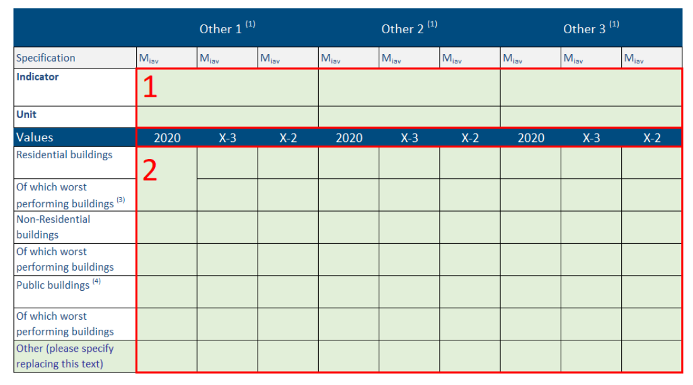
Annex 4 – Table 2 follow up
Other: Other milestones and progress indicators of the long-term strategy (LTRS) for the renovation of the national stock of residential and non-residential buildings – building stock
The purpose of this field is for the CPs to report the name and unit of any other indicators as presented in the national long-term renovation strategy.
e.g. investments for the renovation of the existing stock, construction’s share in GDP, health issues
1. Data format: free text
2: Data format: number (decimal)
Notes:
2029 or 2030 in the guidance !!!

Slide 22
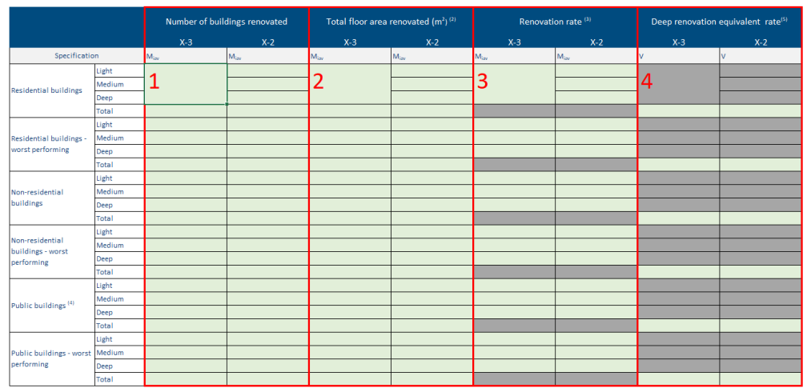
Annex 4 – Table 3 – Purpose of the table - LTRS
Milestones and progress indicators of the long-term strategy for the renovation of the national stock of residential and nonresidential buildings – renovation rate
This table refers to ‘energy renovations’.
An energy renovation means the change of one or more building elements (building envelope and technical building systems), having the potential to significantly affect the calculated or metered amount of energy needed to meet the energy demand associated with a typical use of the building, which includes, inter alia, energy used for heating, cooling, ventilation, hot water and lighting.
1. Data format: free text
2: Data format: number (decimal)
Notes:
Under national and EU funded renovation programmes (e.g. from Cohesion Funds, ERDF, RRP, national programmes and financing schemes), the energy savings should be estimated.
CPs may collect all these info and sum-up savings under each type of renovation depth. All ‘energy renovations’ should be included, not only those related to the use of financial support schemes. Data on the number of buildings renovated can also be derived from administrative databases (e.g. on renovation permits or changes in EPC databases), information on the economic activity of the building sector, sampling, etc.

Slide 23
Annex 4 – Table 3
Milestones and progress indicators of the long-term strategy for the renovation of the national stock of residential and nonresidential buildings – renovation rate
Data format: integer
Data format: numer(decimal)
FIELD 1: Each of the above categories is divided into 4 different indicators called renovation depths which should be reported for each of the years. These indicators are ‘Light’, ‘Medium’, Deep’ and ‘Total’.
FIELD 2-3-4: The purpose of this field is to report on and establish the total building floor area renovated in three historical years. The years are identified as X-3 and X-2, where X is the reporting year. The renovation rates and depths do not refer to individual buildings but to the whole renovated building stock.
Renovation depths level are determined by the ratio between primary energy saved and total primary energy before renovation of the respective part of the stock
Notes:
Definitions:. They are defined on the basis of primary energy savings:
– light (3% ≤ x ≤ 30% savings);
– medium (30% < x ≤ 60% savings); and
– deep - a renovation which transforms a building or building unit (a) before 1 January 2030, into a nearly zero-energy building (b) as of 1 January 2030, into a zero-emission building.
To determine the renovation rates specific figures are needed for the average energy savings of each renovation depth in order to have consistent data on the deep renovation equivalent rate. The above definition for deep renovation cannot always be easily applied for the reporting and therefore deep renovation may be considered as a renovation that generates savings> 60%.
In the absence of adequate data, CPss may also use the methodology and data of the European Commission’s “Comprehensive study of building energy renovation activities and the uptake of nearly zero-energy buildings in the EU (2019)” (13), which provides the average energy savings for each renovation depth per CPs

Slide 24
Annex 4 – Table 3
Milestones and progress indicators of the long-term strategy for the renovation of the national stock of residential and nonresidential buildings – renovation rate
3 Data format: number (%)
4 Data format: number (%)
FIELD 3: The purpose of this field is to report on and establish the renovation rate in three historical years. The years are identified as X-3 and X-2, where X is the reporting year. The renovation rates and depths do not refer to individual buildings but to the whole renovated building stock
FIELD 4: The purpose of this field is to report on and establish the renovation rate in certain calendar years. The years are identified as X-3 and X2, where X is the reporting year. The renovation rates and depths do not refer to individual buildings but to the whole renovated building stock.
Notes:
Field 3- Renovation rate refers to the cumulated affected building floor area [m2] of all buildings that underwent an energy renovation in historic calendar years X-3 or X-2, for different renovation depths, divided by the total floor area [m2] of the building stock in the same period.
Field 4 : This metric is to be recorded for the Total of renovation depths only. Deep renovation equivalent rate equalises/weights the renovation rates at deep renovation depth and can be calculated by the following formula: Equivalent deep renovation rate = [(light renovation depth)*(light renovation rate) + (medium renovation depth)*(medium renovation rate) + (deep renovation depth)*(deep renovation rate)] / (deep renovation depth)] - all factors in %. The light/medium/deep renovation depths are the average ratios between primary energy saved and total primary energy before renovation of the respective part of the stock - all factors in %. As mentioned above, for the purpose of NECP reporting the different renovation depths refer to: – light: 3% ≤ x ≤ 30% savings – medium: 30% < x ≤ 60% savings – deep: > 60% savings The figures on renovation depth can be derived from various sources. Financial support schemes (e.g. Cohesion Funds, ERDF, RRP or national programmes) are a good source of information, although it is necessary to account for, that they often lead to more 38 ambitious renovations due to the financial support provided, compared to renovations not supported by financing schemes. Information on economic activity in the building sector, changes in EPC databases, administrative data on renovation permits, energy figures from Eurostat can provide additional elements for the analysis. CPss may consult the methodology and data of the European Commission’s “Comprehensive study of building energy renovation activities and the uptake of nearly zero-energy buildings in the EU (2019)”.

Slide 25
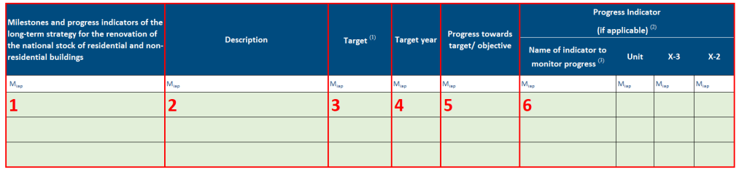
Annex 4 – Table 4
Milestones and progress indicators of the long-term strategy for the renovation of the national stock of residential and nonresidential buildings – other indicators
Data format: text
text
number (integer)
text
text
text
number (decimal)
text
FIELD 1: The purpose of this field is to provide the name of a milestone/progress indicator that is supporting the implementation of the long-term strategy for the renovation of the national stock of residential and non-residential buildings.
FIELD 3: The Commission’s Staff Working Document SWD (2022) 375 final “Analysis of the national long-term renovation strategies”, and JRC’s report “Assessment of first longterm renovation strategies under the Energy Performance of Building Directive (Art. 2a)” present different examples of the indicative milestones selected and the relevant targets.

Slide 26
Annex 4 – Table 4
Milestones and progress indicators of the long-term strategy for the renovation of the national stock of residential and non residential buildings – other indicators
Data format: text
text
number (integer)
text
text
text
number (decimal)
text
FIELD 4: his field shall indicate the target year(s) which should be in line with the national LTRSs. They should report the targets/indicative milestones for 2030, 2040 and 2050 (or for any other target year) in different rows.
FIELD 5: […]providing an update on the progress made towards a specific indicator in quantitative terms or by explaining which policies or actions have been put in place which will support the achievement of the target and how these policies and actions are performing against the set milestones.
FIELD 6: The purpose of this field is to report on the progress indicator towards the target outlined in FIELD 3. If the target/objective is quantifiable, they have to provide an indication of progress, with the latest available information. Indicators for reporting are to be determined on the basis of national objectives or targets

Slide 27
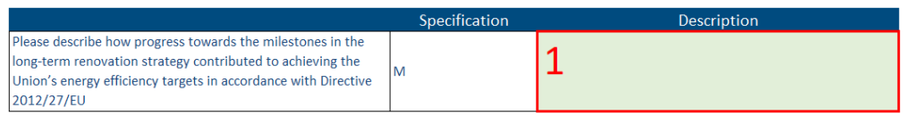
Annex 4 – Table 5
Milestones and progress indicators of the long-term strategy for the renovation of the national stock of residential and non residential buildings - the contributions to the Union's energy efficiency targets
In accordance with Article 2a paragraph 2, the LTRS must specify how the milestones for 2030, 2040 and 2050 contribute to the indicative headline target defined in accordance with Article 3 of the Energy Efficiency Directive, since buildings are a key pillar of energy efficiency policy.
Notes:
This field shall include a description of the progress in a comprehensive way.
Please describe how progress towards the milestones in the long-term renovation strategy contributed to achieving the Union’s energy efficiency targets in accordance with Directive 2012/27/EU.
Here reference should be made to the contribution of the building sector in achieving a reduction of PEC and FEC in accordance with the national target established under Article 3 of the Energy Efficiency Directive.
Each CP can determine the share of the energy consumed in buildings as well as their absolute values (FEC and PEC).
CPs should report on its evolution over time and how the building stock’s renovation and the improvement of its overall energy performance contribute to the achievement of the targets established under Article 3 of the Energy Efficiency Directive.
The calculation of the contribution of the building sector should focus on the reductions in energy consumption (both final and primary) which can be attributed to energy renovations. Therefore, the energy consumption which relates to new constructions or energy uses outside the scope of the EPBD (e.g. for appliances) should not be included. Energy decomposition exercises could help in such analysis. For example: a CPs has a baseline of FEC 125 ktoe and an objective of 100 ktoe, resulting in a reduction of 25 ktoe. If the FEC for existing buildings is reduced by 10 ktoe, then the contribution of the LTRS to the EED target is 40% (10 / 25 ktoe). The methodology followed should be briefly described. Together with the description, please make appropriate use of the references/links to direct users to documents and websites with more detailed information, if available. Reporters can also upload supporting documentation to the Attachments schema.

Slide 28
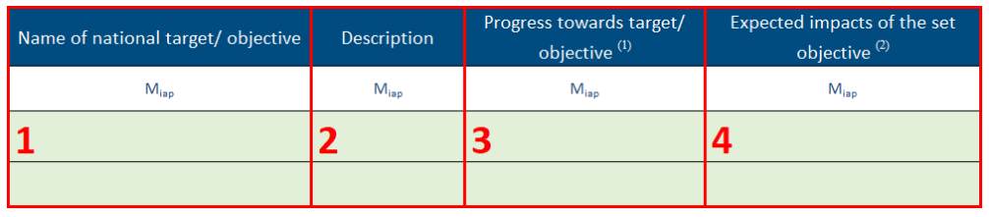
Annex 4 – Table 6
Update of other national objectives on energy efficiency as reported in the integrated national energy and climate plan
Data format: text (all)
Purpose:
provide the name of a national target/objective as reported in each CPs NECP
give context on the national target/ objective and describe the aim
report on progress towards meeting the national target/objective
report on expected impacts of the set objective
Notes:
3: If targets were set, an overview of the main actions and achieved milestones should be given. If targets were not set, then an update on whether targets have since been set and a description of the targets should be provided. Progress made towards a national target/objective can be reported by providing an update on the progress made towards a specific indicator or by explaining which policies or actions have been put in place which will support the achievement of the target and how these policies and actions are performing against set milestones.

Slide 29
Annex XVII
Thematic guidance
Notes:
Odysseas PLATSAKIS

Slide 30
ADDITIONAL REPORTING - Energy Efficiency
Article 21 (c) – Additional reporting obligations in the area of energy efficiency
By 15 March 2025 and every second year thereafter, CPs shall report on information pertaining to energy efficiency measures within buildings: (1) the reasons behind stable or growing energy consumption; (2) the condition and energy performance of public building; (3) the extent of energy audits conducted in large enterprises; (4) the new NZEBs and renovated buildings meeting NZEB standards.
Reports due: | 15 March – Biannually – To start in 2025

Slide 31
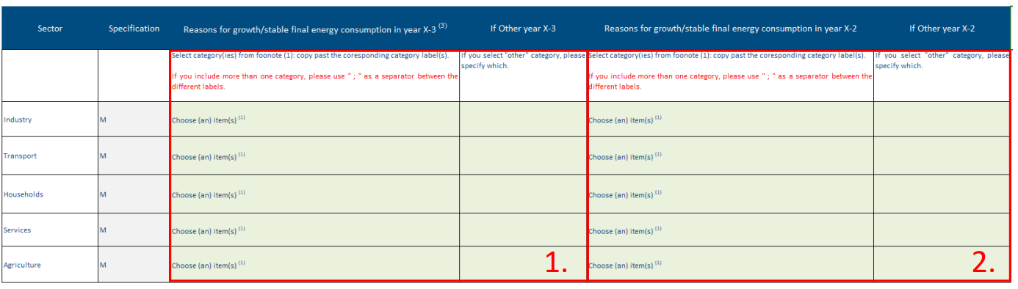
Annex 17 – Table 1
Progress in each sector and reasons why energy consumption remained stable or was grooving in FEC sectors
■ Economic growth;
■ Decline of fuel prices;
■ Increase of value added;
■ Increase of employment;
■ Increase of transport of goods;
■ Increase of transport of passengers;
■ Increase of population and/or households;
■ Increase of disposable income of households;
■ Worsening of winter climatic conditions;
■ Worsening of summer climatic conditions;
■ Exceptional event;
Change in the methodology of measurement or calculation of energy consumptions;
■ Other
Sectors
REASON
The purpose of these fields is to report on and establish the reasons why energy consumption remained stable or was growing in final energy consumption sectors (Industry, Transport, Households, Services, Agriculture, Other sectors) in past calendar years. Additional sectors may be added and specified under ‘Other’. The years concerned are X-3 and X-2, where X is the reporting year.

Slide 32
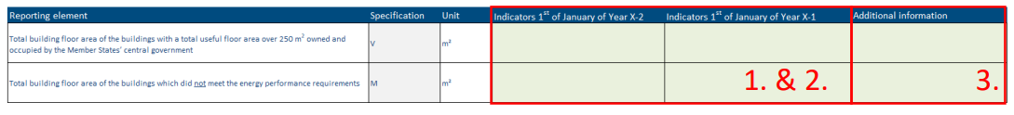
Annex 17 – Table 2
Total building floor area of the buildings with a total useful floor area over 250 m2 owned and occupied by the central government that, on 1 January in year X-2 and X-1, which did not meet the energy performance requirements referred to in Article 5(1) of EED
number (decimal)
text
Field 1-2: The purpose of this field is to report on and establish the total building floor area of the buildings with a total useful floor area over 250 m2 owned and occupied by the central government AND total building floor area of the buildings which did not meet the energy performance requirements.

Slide 33
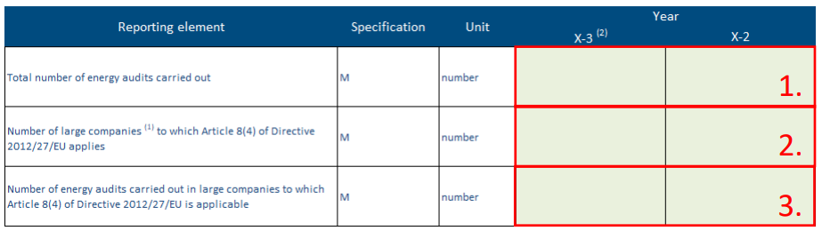
Annex 17 – Table 3
Number of energy audits carried out in in year X-3 and X-2. In addition, the total estimated number of large companies in their territory to which Article 8(4) of EED is applicable and the number of energy audits carried out in those enterprises in the year X-3 and X-2
number (integer)
FIELD 1-2: The purpose of this field is to report on total number of energy audits carried out in historic calendar years, as well as of large companies. The years are identified as X-3 and X-2, where X is the reporting year.
FIELD 3: The purpose of this field is to report on the number of energy audits carried out in large companies to which Article 8(4) of the Energy Efficiency Directive is applicable in historic calendar years. The years are identified as X-3 and X2, where X is the reporting year. According to Article 8(4), they shall ensure that enterprises that are not SMEs are subject to an energy audit carried out in an independent and cost-effective manner by qualified and/or accredited experts or implemented and supervised by independent authorities under national legislation. Energy audits need to be performed at least every four years.
Notes:
An energy audit is a systematic procedure with the purpose of obtaining adequate knowledge of the energy consumption profile of a building or group of buildings, an industrial or commercial operation or installation, or a private or public service, identifying and quantifying cost-effective energy saving opportunities, and reporting the findings. Energy audits have to be carried out at least every four years and be base
According to Article 8(4), CPss shall ensure that enterprises that are not SMEs are subject to an energy audit carried out in an independent and cost-effective manner by qualified and/or accredited experts or implemented and supervised by 1. 2. 3. 52 independent authorities under national legislation. Energy audits need to be performed at least every four years
The definition for the enterprises in scope of Article 8(4) of the EED follows the European Commission’s definition for small and medium-sized enterprises (SMEs), as included in Commission Recommendation 2003/361/EC. Whether an enterprise is an SME or non-SME is in first stance based on three criteria: staff headcount, annual turnover and annual balance sheet total (Commission Recommendation 2003/361/EC). Non-SMEs are those that employ 250 or more persons (headcount) and have either annual turnover more than EUR 50 million or total assets of more than EUR 43 million. But the definition also takes the dependence of the enterprise on other enterprises into account as well.

Slide 34
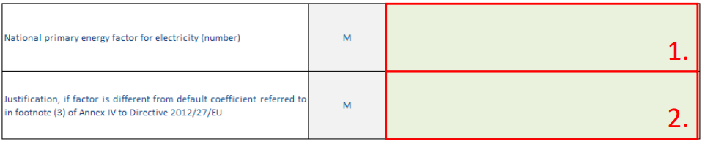
Annex 17 – Table 4
Applied national primary energy factor for electricity and a justification, if this is different from the default coefficient referred to in footnote (3) of Annex IV to EED
number (decimal)
text
FIELD 1: The purpose of this field is to report on the national primary energy factor for electricity.
FIELD 2: The purpose of this field is to provide justification if the factor in field 1 differs to the Directive.
Notes:
When energy savings are calculated in primary energy terms using a bottom-up approach based on final energy consumption, CPss have to apply a coefficient established through a transparent methodology on the basis of national circumstances affecting primary energy consumption, in order to ensure a precise calculation of real savings. Those circumstances have to be substantiated, verifiable and based on objective and non-discriminatory criteria. For savings in kWh electricity, CPss may apply a default coefficient of 2,1 or use the discretion to define a different coefficient, provided that they can justify it. When doing so, CPss has to take into account the energy mix included in their integrated national energy and climate plans.
Footnote (3) of Annex IV to the Energy Efficiency Directive stipulates that the default coefficient is applicable when energy savings are calculated in primary energy terms using a bottom-up approach based on final energy consumption. For savings in kWh 1. 2. 54 electricity CPss may apply a default coefficient of 2,1. CPss may apply a different coefficient provided they can justify it.

Slide 35
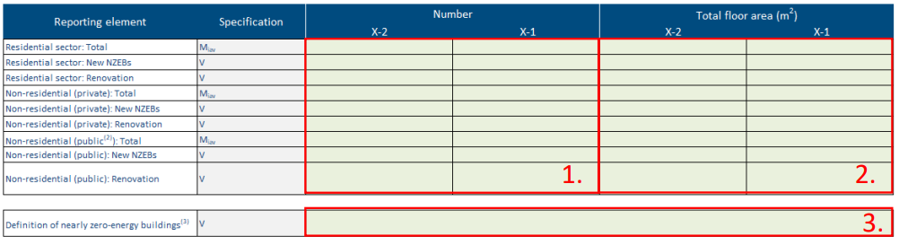
Annex 17 – Table 5
Number and floor area of new and renovated nearly zero-energy buildings (1) in year X-2 and X-1, as provided in Article 9 of EPBD, where necessary based on statistical sampling
number (decimal)
number (integer)
FIELD 1: The purpose of this field is to report on the number per building sector (residential, public and private non-residential sector) of new and renovated Nearly Zero-Energy Buildings (NZEBs). The reporting is required for two consecutive historic years starting from 1 January of X-2 and 1 January of X-1 on a number of reporting elements: Total, New NZEBs and Renovation individually for Residential, Non-residential (private) and Non-residential (public) sectors
FIELD 3: The definition of NZEB can be provided in this field in the form of a short description. It is recommended to cite where the definition comes from (i.e., legislation, strategy)
Notes:
1 Definitions: NZEB buildings are not defined in terms of a specific primary energy saving threshold, but according to official national NZEB definitions transposing Article 9 of the EBPD. These national transpositions are according to the framework definition of Article 2 of the EPBD, namely “Nearly zero-energy building means a building that has a very high energy performance, as determined in accordance with Annex I of the EPBD. The nearly zero or very low amount of energy required should be covered to a very significant extent by energy from renewable sources, including energy from renewable sources produced on-site or nearby”.

Slide 36
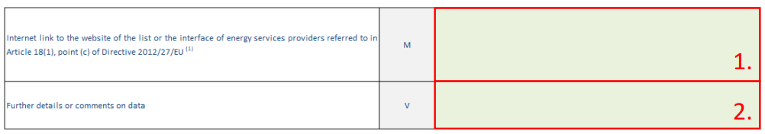
Annex 17 – Table 6
Internet link to the website where the list or the interface of energy services providers referred to in Article 18(1), point (c) of Directive 2012/27/EU as adapted and adopted by Ministerial Council Decisions 2015/08/MC-EnC, 2021/14/MC-EnC and 2022/02/MC-EnC can be accessible
The purpose of this field is to record the website where the list or the interface of energy services providers is captured.

Slide 37
Reportnet 3
Logging in & set-up

Slide 38
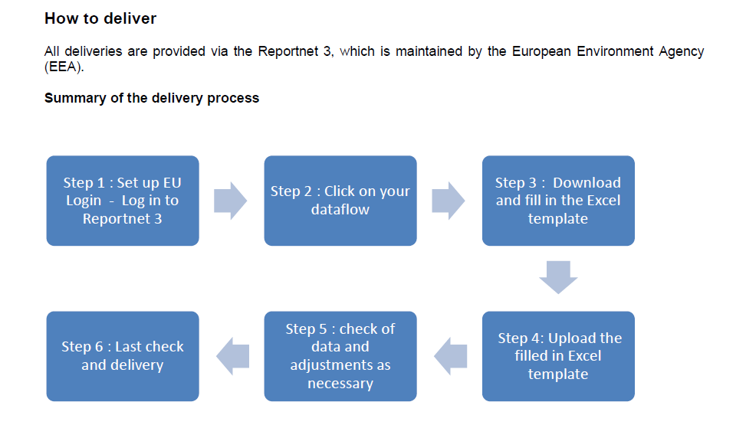

Slide 39

Dataflow: Logging into Reportnet

Slide 40
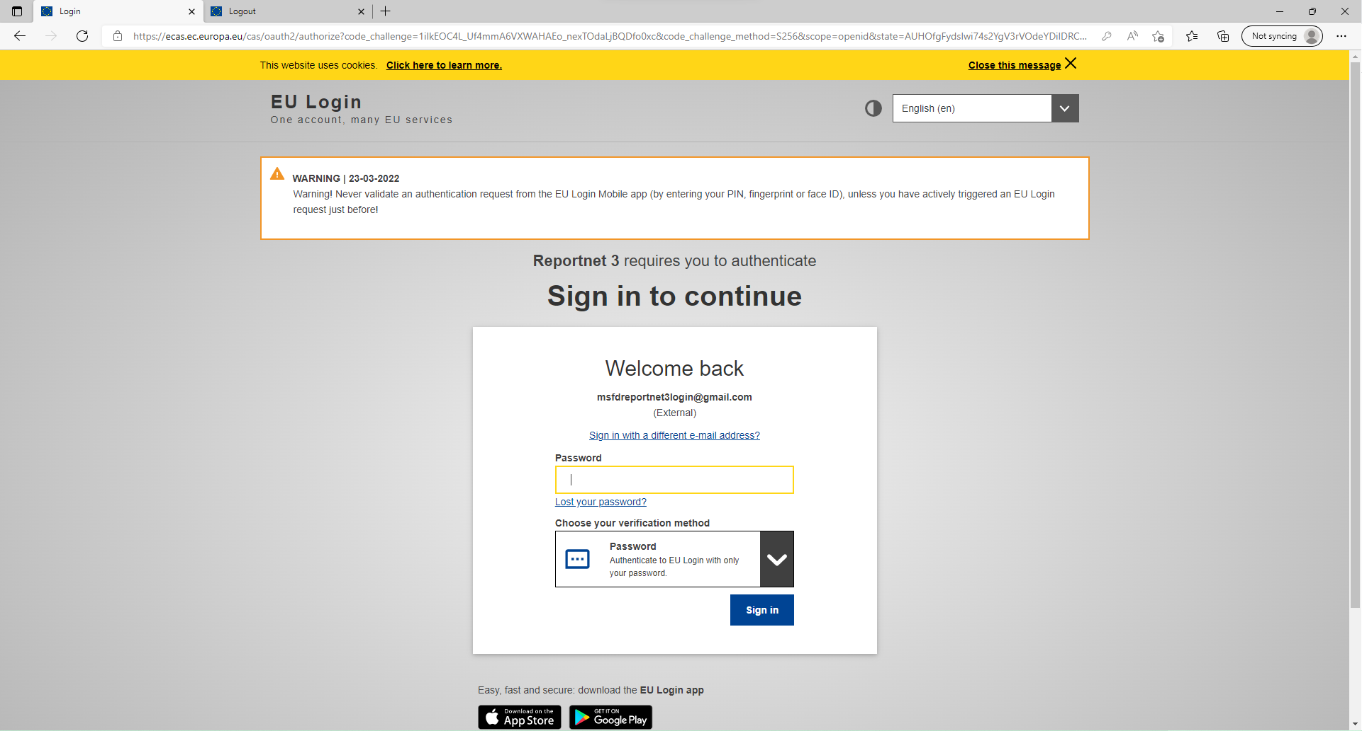

PaMs: Logging into Reportnet
Guidance on getting EU login and registering on the platform can be found in this document.
Multi-factor authentication (MFA) now required to access Reportnet 3. Guidance to set this up in this document.

Slide 41
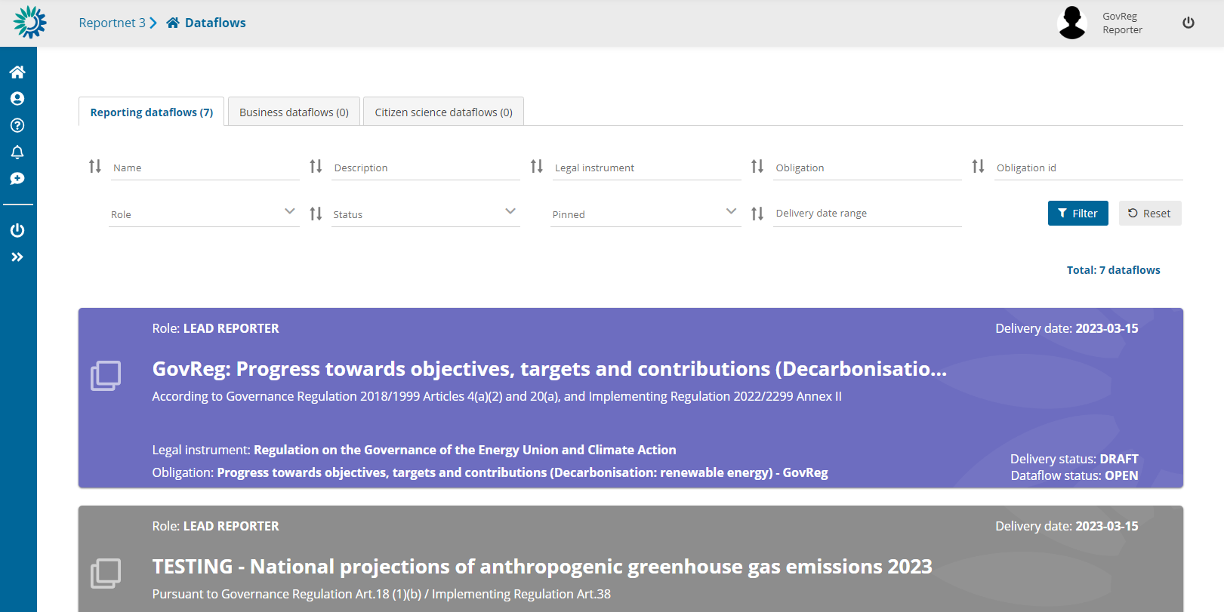
Open dataflow: Purple
Closed dataflow: Grey

Slide 42
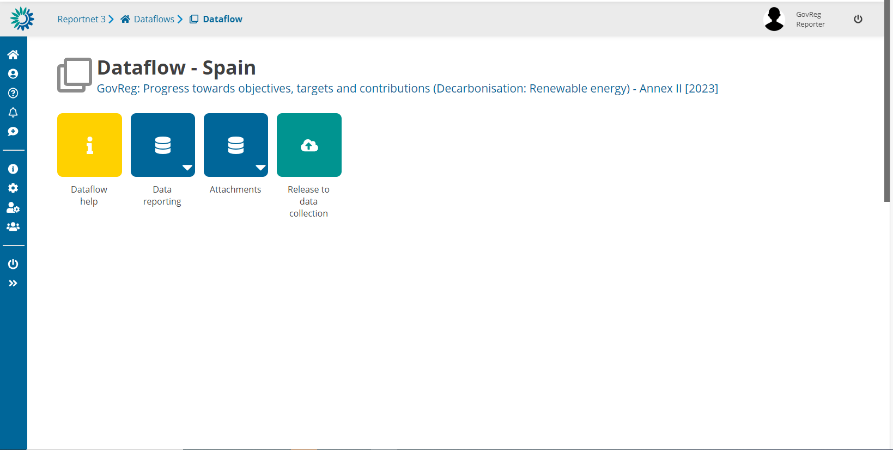
Notes:
Rodrigo PEREZ

Slide 43
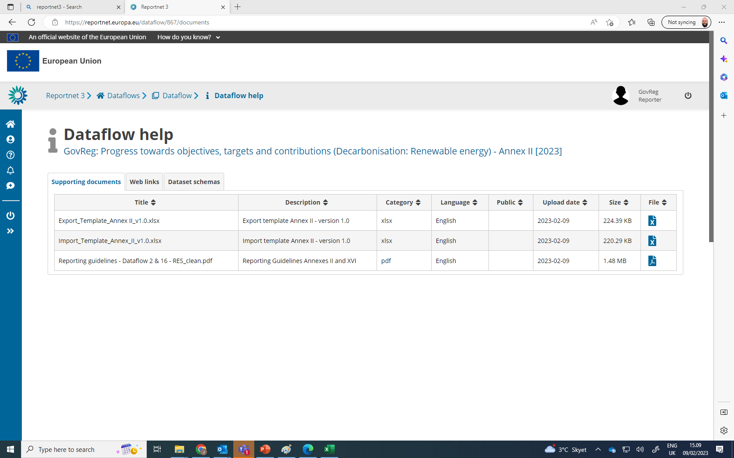
Reporting guidance documentation
Import templates
Useful weblinks
Download link(s) here
Notes:
Rodrigo PEREZ

Slide 44
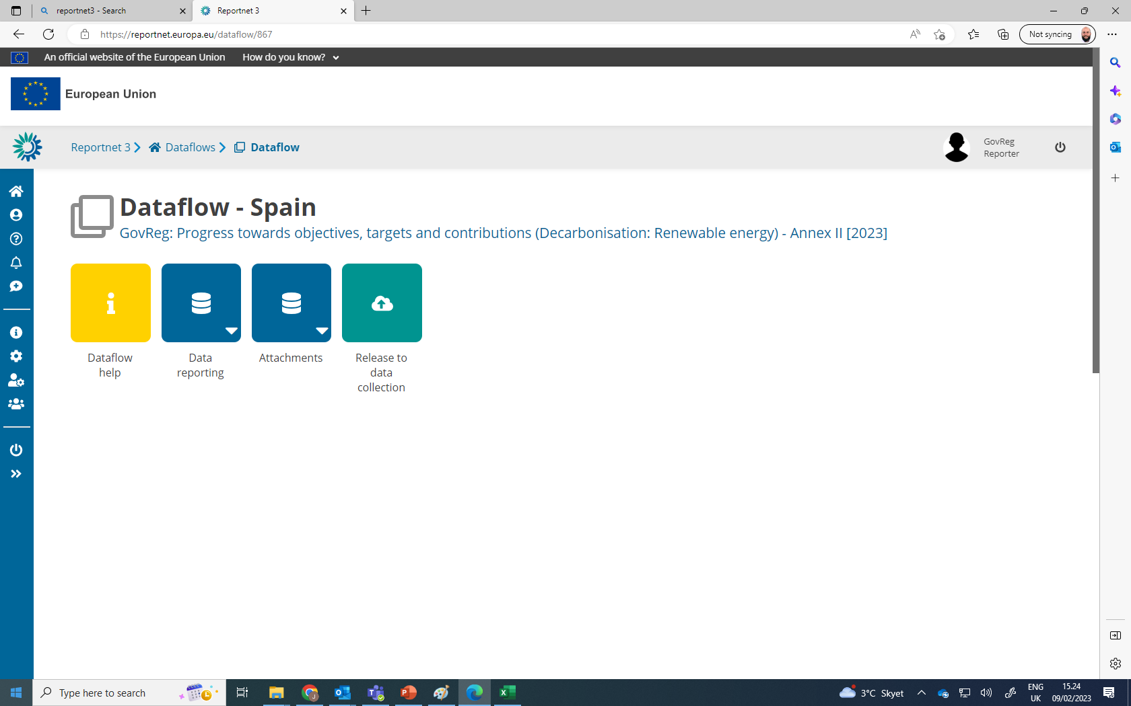
Dataflow user list:
View who is selected as reporters
Manage reporters (as lead reporter):
Add additional reporters to access dataflow
Reporters cannot release to data collection
Notes:
Rodrigo PEREZ

Slide 45

Reportnet 3
Data input - overview
Notes:
Stephane

Slide 47




Overview of dataflow page
1.
2.
3.
4.
1. Navigation bar
Reporter management
Notifications!
2. Dataflow help
Documentation
Guidance
Legislation
3. Reporting schema
Where to report data
Focus on data reporting
Attachments to supplement reporting
4. Release data
The button to officially submit data

Slide 48




Where can I access “prefilled” data?
Prefilling / Post-filling is data that is not reported within this dataflow in Reportnet.
Reported data
To be filled in by CPs in Reportnet 3
Prefilled data
Information provided by CPs prior to 15 March in other means (i.e. Eurostat)
Post-filled
Information being provided by CPs simultaneously to 15 March in other dataflow(s) (i.e. Eurostat)
Calculations
Calculations based on reported values
Prefilled data can be downloaded & reviewed via excel exports in Reportnet 3
If issue of prefilled data: contact data provider!!

Slide 49

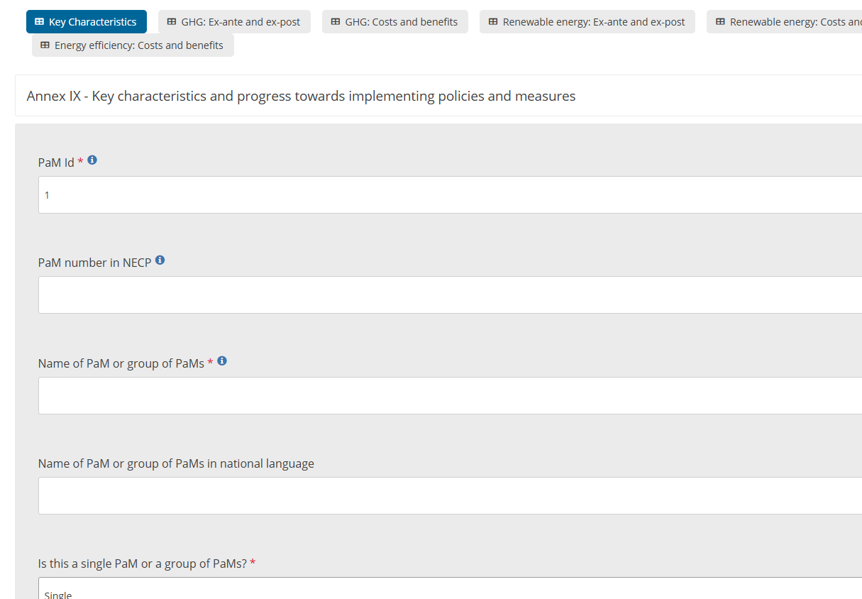
Reportnet: Webform
Webform
Simplified data entry in system – Is an easier way to directly input data without complex IT interface (tabular data).
Data formats assured – reporting via the webform only allows the correct values to be input (text, numbers, lists), ensuring a reduced quality check process required.
Direct QC review – quality checks are directly visible in the webform in a more user-friendly mode, to help with updating such issues.

Slide 50


Reportnet 3
Data input – excel import

Slide 51

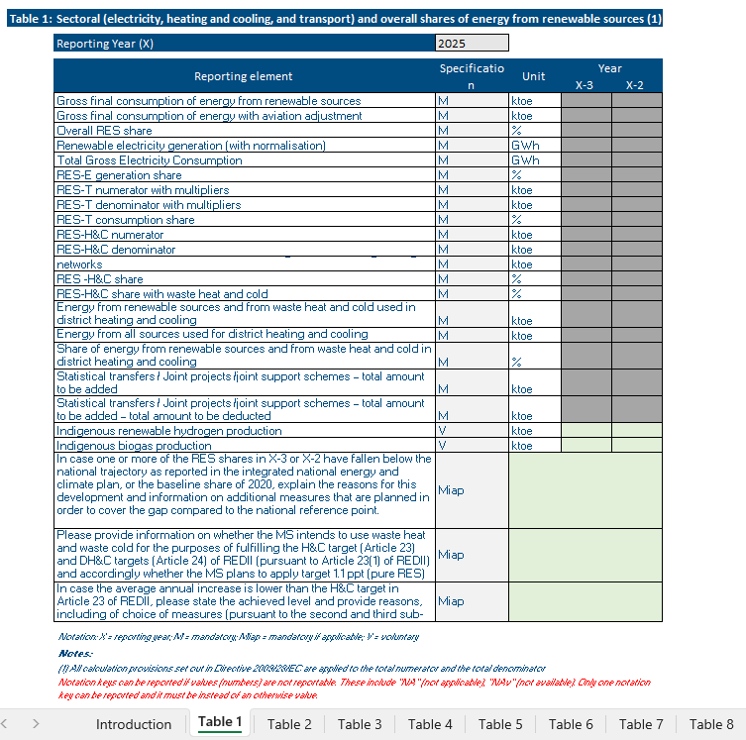
Reportnet: Excel import / Reportnet 3 tabular editing
Excel import
Easy to use - Excel follows structure of legislation.
Prefilling/Post-filling overview - Highlights where data should be reported (green cells) and where no reporting in Reportnet 3 is required (grey cells – prefilled / post-filled).
Risk – If import not used correctly can cause issues on the finally imported data to Reportnet 3.
Do not edit data formats / structures – be careful when copying and pasting!
Excel import does not equal reporting – reporting is only considered complete once an official submission in the platform is made. Therefore, once data is imported, quality checks and final check of data is required!
Notes:
Please treat this Excel template as a well-structured and delicate framework

Slide 52
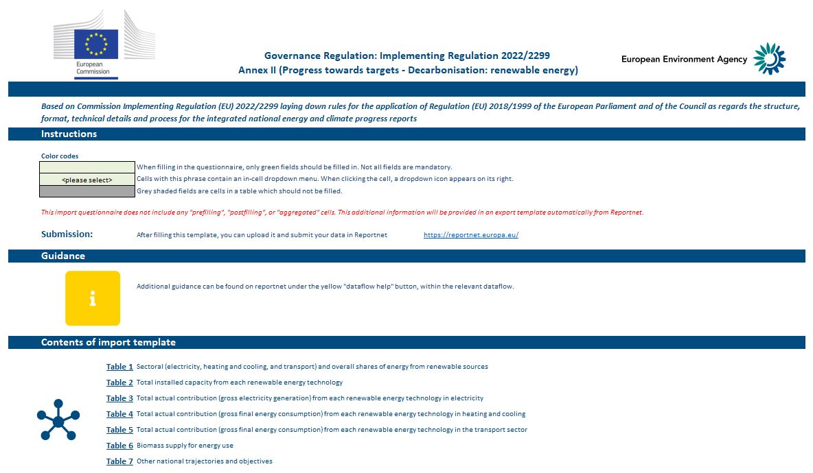
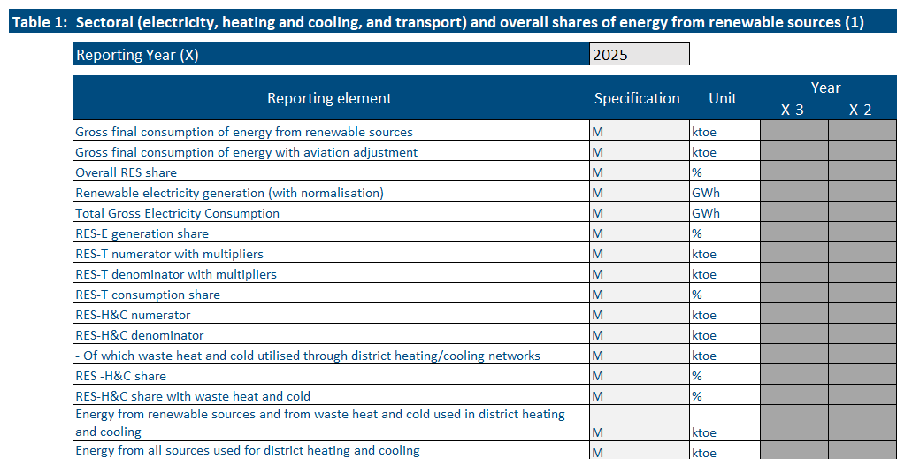
Using the excel import
Excel import templates are split into two parts:
Introduction
Provides information on the import template
Legal reporting tables
Copies legislation format: green = CPs input!
! Do not edit formatting or structure of template !
It is the CPs responsibly to ensure the data is imported correctly to Reportnet 3.

Slide 53
Notation keys: In case there is no data available
What is a Notation Key?
A system to clarify lack of numerical data (where unavailable or not applicable).
Required for mandatory if applicable (Miap), if available (Miav), or voluntary (V) reporting.
Notation key | Description
NA | Not applicable - For data and activities in a reporting country that are not applicable or relevant to the context of the reporting country. Anticipated to be used in the context of Miap and V reporting fields. This notation key can be used instead of a value or 0, to ensure complete reporting.
NAv | Not available – For data and activities in a reporting country that are applicable to the context of the reporting country, however the data is not available. Anticipated to be used in the context of Miap, Miav and V reporting fields. This value can be used instead of a value or 0, to ensure complete reporting.
C | Confidential – Specifically for Annex II, Table 5, reporting on greenhouse gas savings performance of biofuels. This notation key is for data and activities in a reporting country that are available but are confidential and therefore cannot be reported publicly at a disaggregated level.
Import templates provide overview of when notation keys are accepted
For any issues check the reporting guidelines!
GHG (Annex I)
RES (Annexes II & XVI)
EE (Annexes IV & XVII)
Applicable to these dataflows
Notes:
There is also a few minor improvements here and there, of which clarifications in footnotes that were found not clear enough in previous data collection round

Slide 54
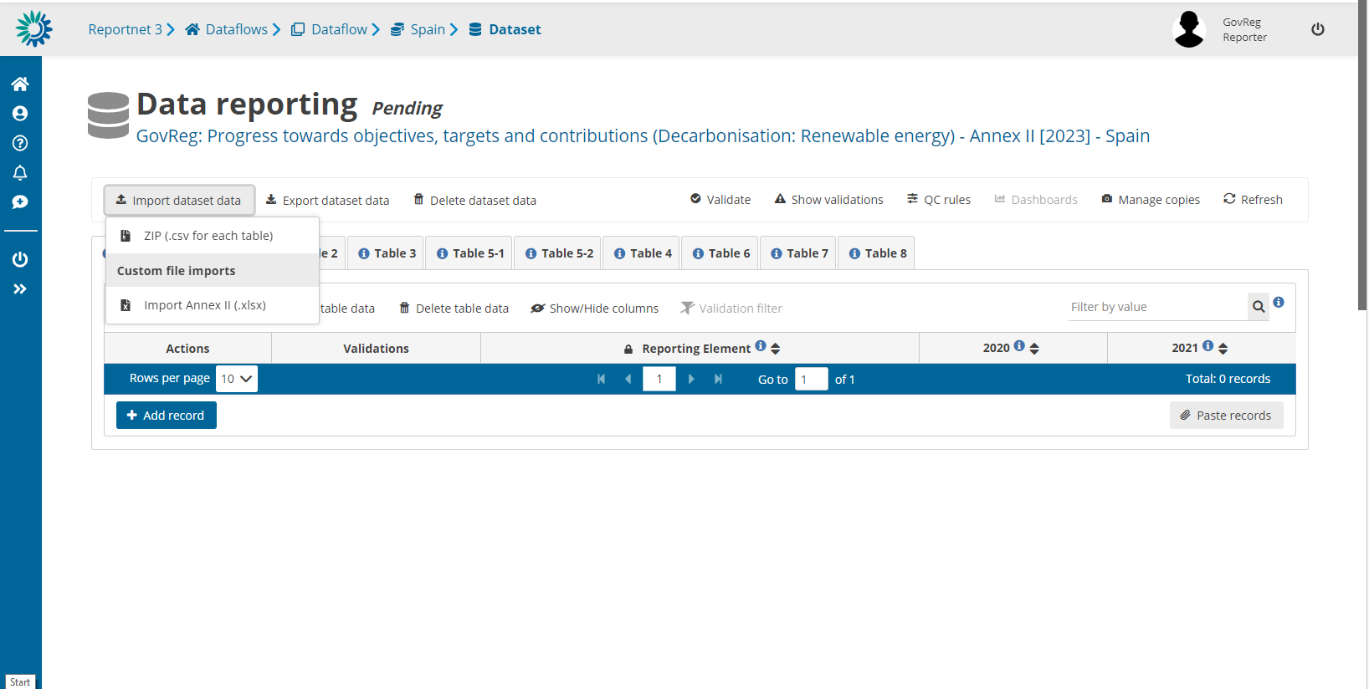
Imports
Notes:
Rodrigo PEREZ

Slide 55
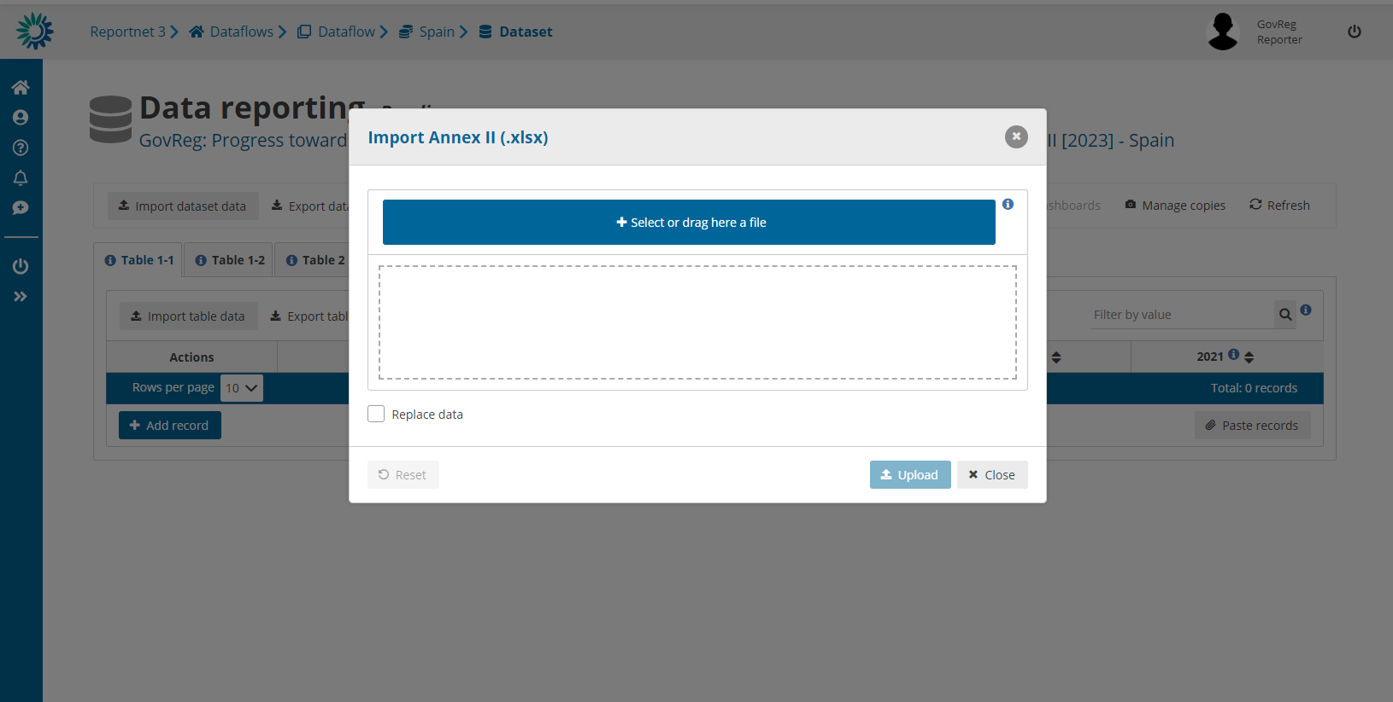
Imports – select the import file and upload!
Notes:
REPLACE DATA AND REFRESH

Slide 56



Imports – check final data in Reportnet!
Review that data was imported correctly
Validate data in system to ensure format and data is to quality standards
Notes:
After some time

Slide 57
Reportnet 3
Data input – excel export
Notes:
Rodrigo PEREZ

Slide 58
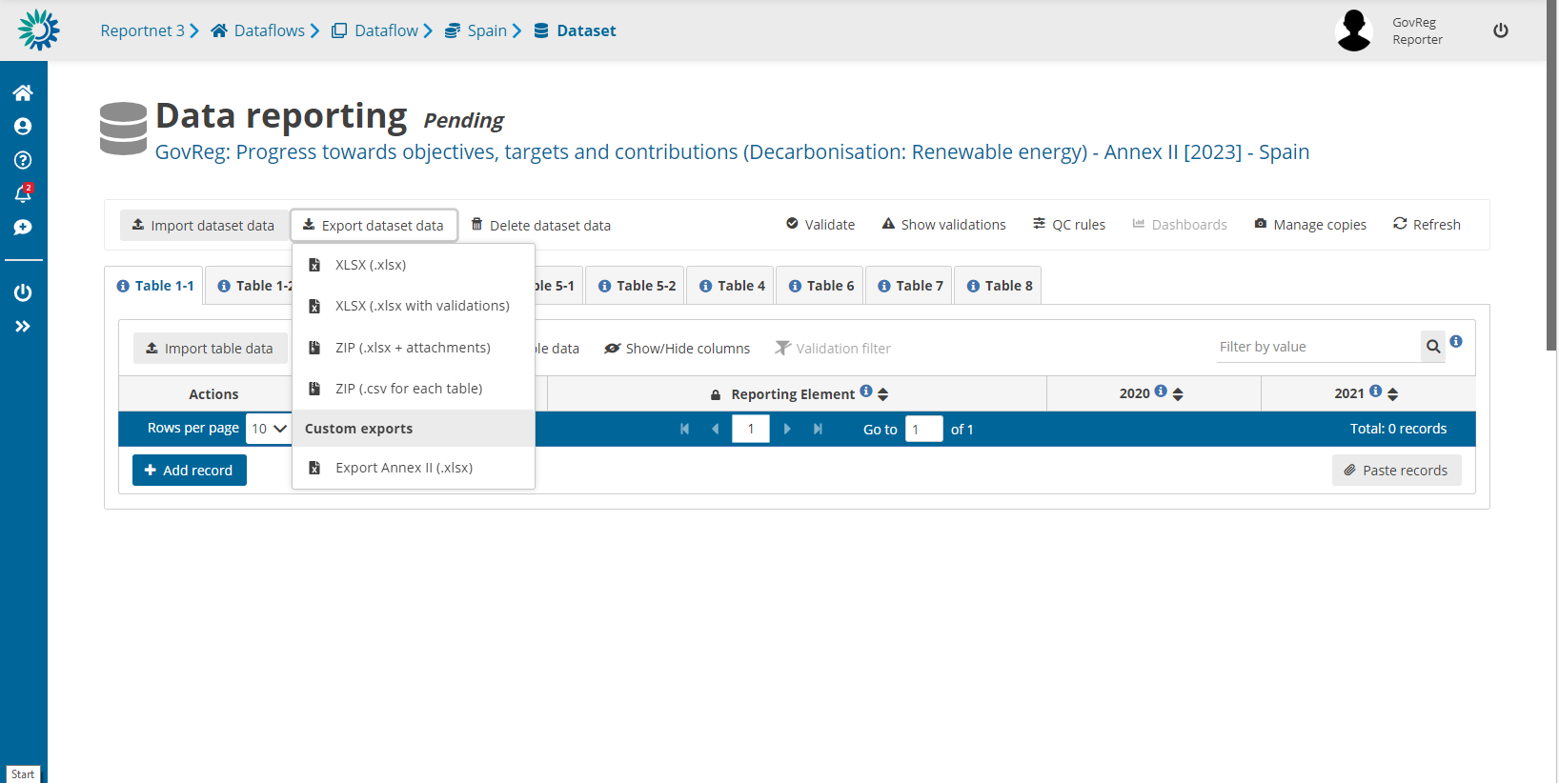
Exports – where to download the file

Slide 59
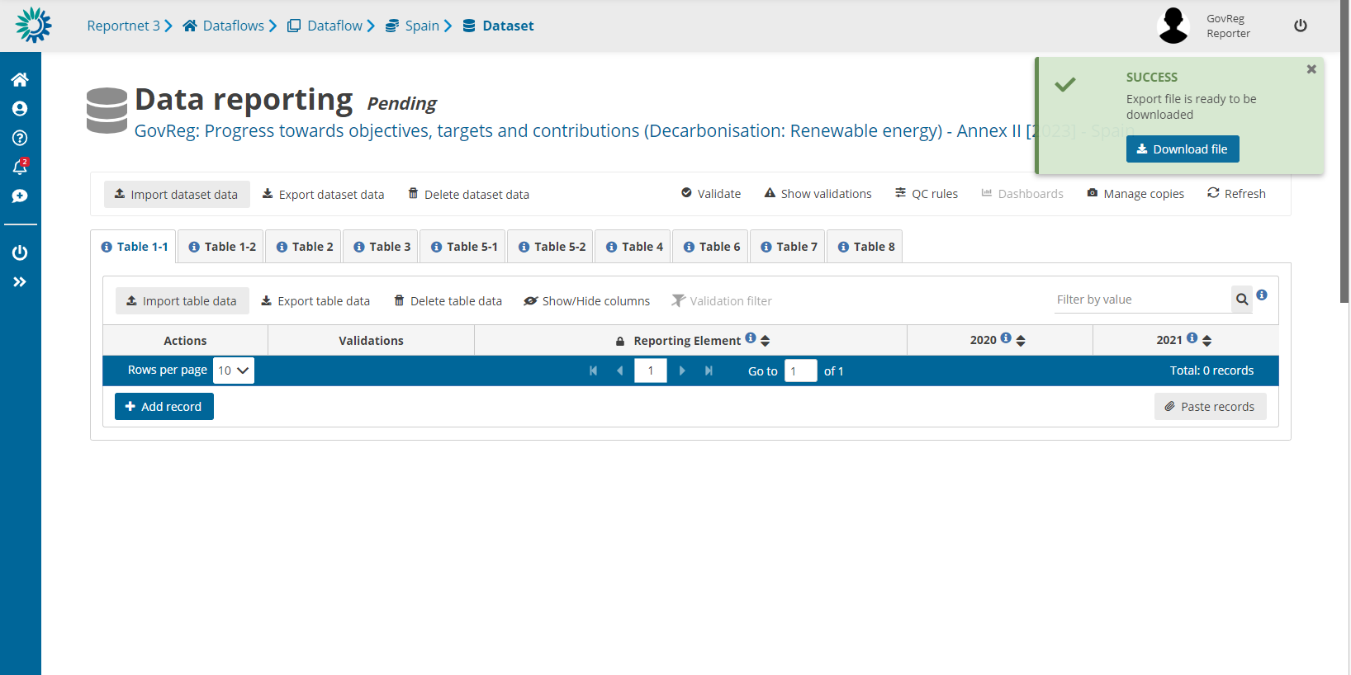
Exports – download takes a few moments

Slide 60
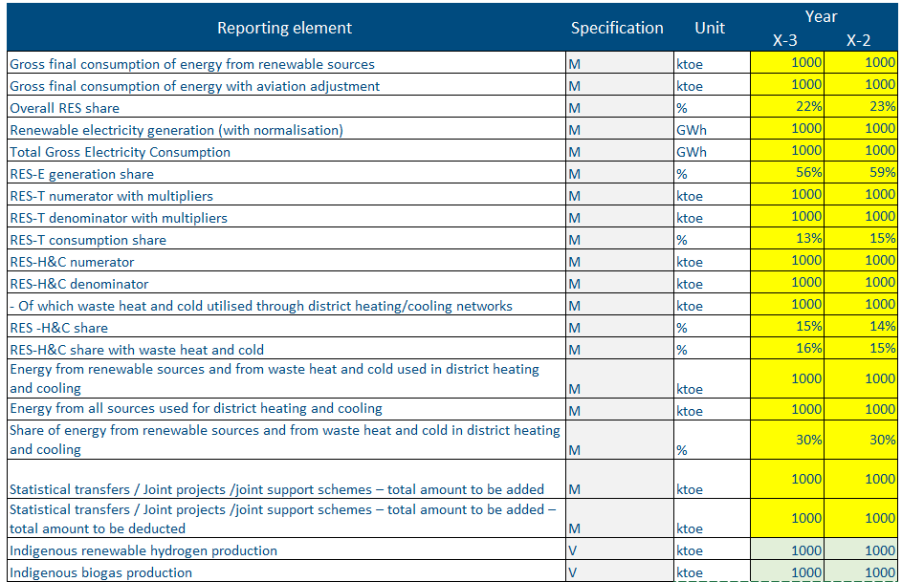
Purpose of exports
Purpose of exports:
To export reported values (green cells)
To review prefilled (Eurostat data) (yellow cells)
Export templates can be used again as an import template.
! Please note: Eurostat (prefilled) data cannot be imported into Reportnet only ‘green cell’ values !
Dataflows with prefilling:
RES (Annexes II & XVI)
EE (Annex IV)
Notes:
Green - reported data - data to be reported by MS (in Reportnet or ReportENER).
Yellow - prefilling - data that comes from external sources prior to the reporting deadline therefore MS do not need to re-report (i.e., from ESTAT or EC consultants).
Orange - postfilled - data that comes from external sources submitted at the same time as this reporting obligation and therefore will be added to the data source after the fact (i.e. data from GHG inventory or GHG projections).
Blue - calculated fields - no need for reporting as the values will be automatically calculated in the final dataset based on methods clearly defined in the footnotes of the legislation.

Slide 61

Reportnet 3
Quality assurance - validations

Slide 62
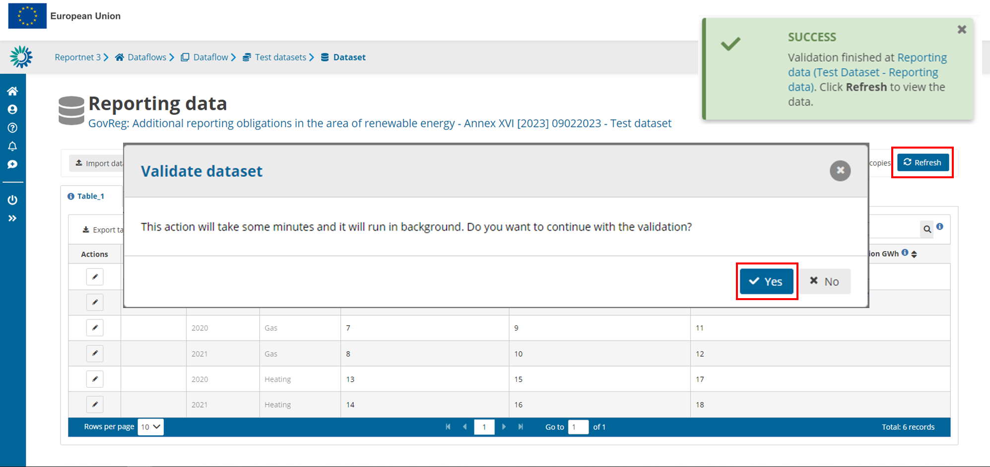
Validation
The platform validates imported data thanks to automatic quality checks implemented in Reportnet 3 and according to predefined validation rules.
→ After having imported the filled in template → click on Validate, and Refresh
Notes:
Rodrigo PEREZ

Slide 63



Validations – types of errors
Warning (can release data)
Error (can release data)
Blocker (can’t release data)

Slide 64
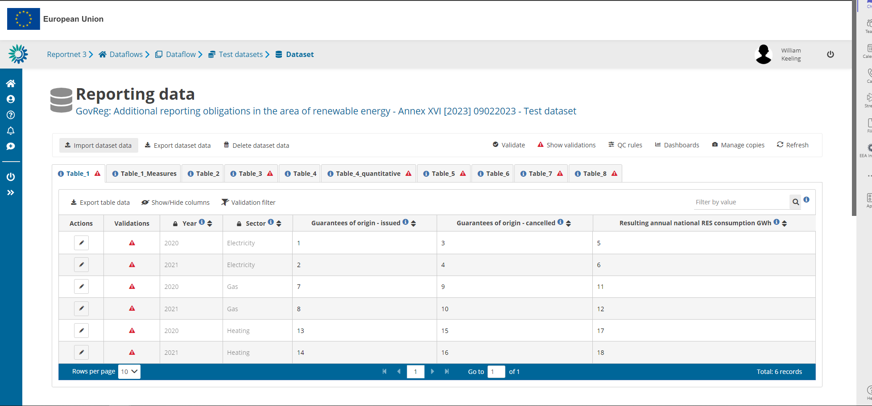
Validations – reviewing errors in the dataflow
Add any number of slides for print screens for this Section
1. Table level errors
2. Record level errors
3. Specific errors

Slide 65

Validation
Blocking errors require a change of the reporting data. Release cannot be performed.
Two ways to correct or update data:
Correct the Excel template and re-import the updated template
When re-importing a modified template, always click on “Replace data” before importing and validating an updated template
✓ Correct the fields directly in Reportnet by clicking on the field.
In any case, the data must be validated → “Validate” and “Refresh”.

Slide 66

Reportnet 3
Release of data - submission
Notes:
Rodrigo PEREZ

Slide 67
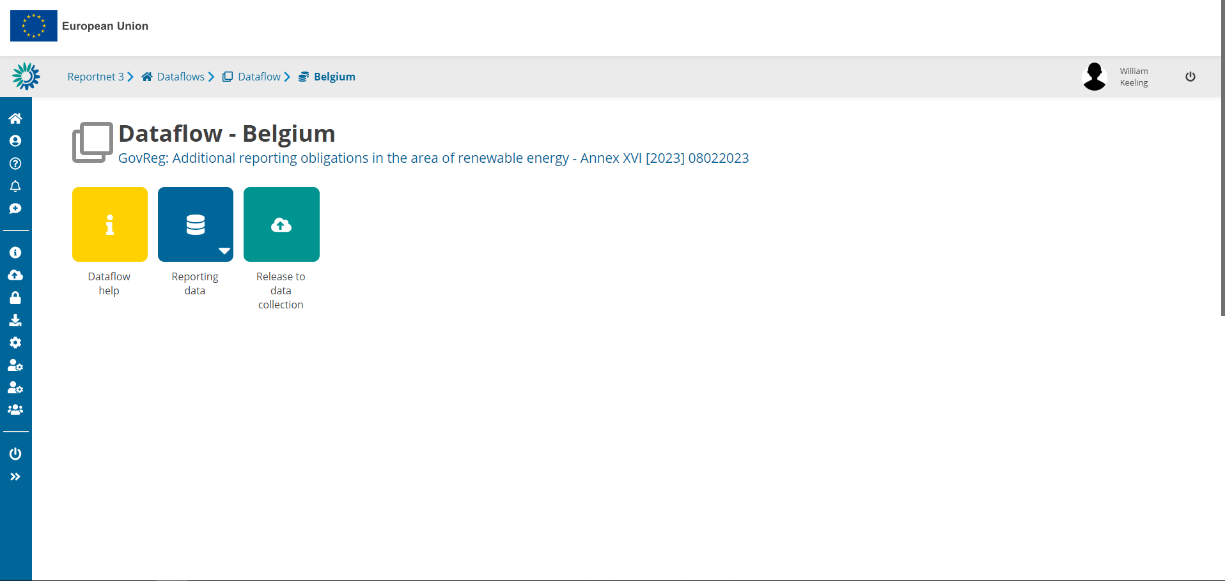
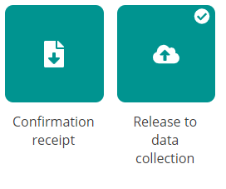
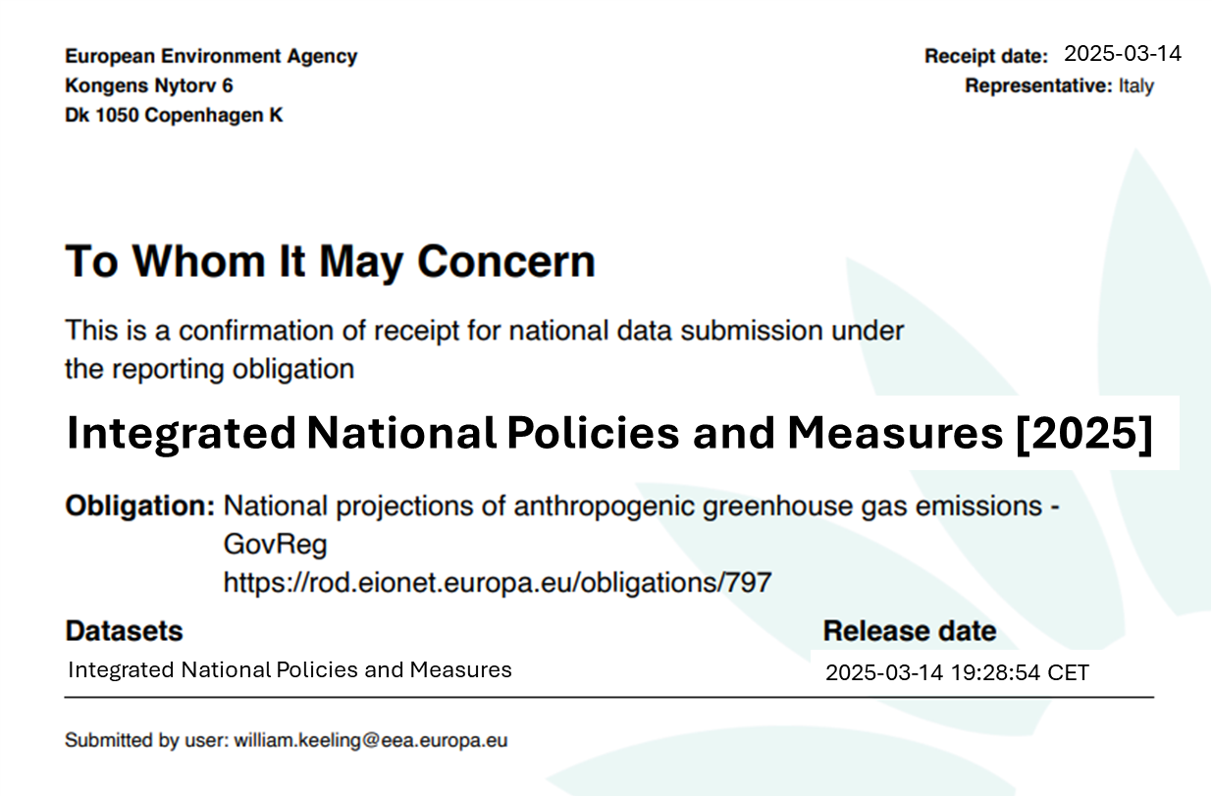
Data submission
Add any number of slides for print screens for this Section
Releasing data can take a while
This can run in the background while you do other tasks!
Notes:
Rodrigo PEREZ

Slide 68

Next steps
Quality assurance and final datasets

Slide 69



Next steps – submission, quality checks, assessment
Deadline for reporting:
15 March 2025
Quality assurance:
15 March – 15 June
Final dataset:
End June
Assessment & analysis:
July – October
It will not be possible to extend after August (6 weeks needed before).

Slide 70
Next steps – quality checks
T
imeliness
T
ranspanrecy
A
ccuracy
ETC to prepare list of possibly quality issues (COMLOG) to be shared with CPS after 15 March.
CPs requested to resubmit data officially in Reportnet 3.
ETC-EEA will only make updates to final dataset in communication with CPs.
C
ompletness
C
onsistency
C
oherence & comparability

Slide 71

If questions – please reach out!
For questions: magdalena.jozwicka@eea.europa.eu
Notes:
If you have any issues with the platform, questions, or would like to request any form of assistance from us, please do not hesitate to contact us. We will be happy to support you. I am sharing our emails here on this slide. You can reach out to me if you have any questions regarding reporting, and you can reach out to my colleague Marc if you have any technical issues.

Slide 72
Thank you
© Alice van Kempen, Well with Nature /EEA
Notes:
Closing slide: you may want to use the same image as in the opening slide and thank your listeners.

Slide 73

Exercise

Slide 74
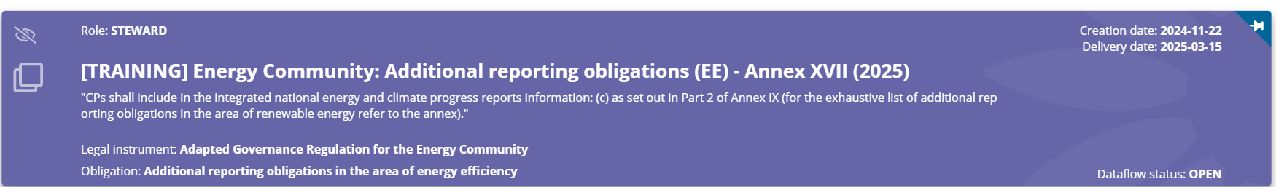
Exercise
Log into Reportnet, access the Annex XVII and open the reporting guidelines
Review the tables
Note any questions or concerns
If you want, try to add some data and try to validate them

Slide 75

Questions?
Answer the following questions as a group:
Are you able to identify the data needed?
Do you think you will manage to submit it?
For questions: magdalena.jozwicka@eea.europa.eu
Notes:
If you have any issues with the platform, questions, or would like to request any form of assistance from us, please do not hesitate to contact us. We will be happy to support you. I am sharing our emails here on this slide. You can reach out to me if you have any questions regarding reporting on climate adaptation, and you can reach out to my colleague Marc if you have any technical issues.

